Slide 1
Predicting Food Security with Machine Learning
Yujun Zhou, Kathy Baylis, Erin Lentz, Hope Michelson
Agricultural and Consumer Economics
University of Illinois
IPAD presentation 10/17/2019
Notes:
Varun Kirshagar

Slide 2
The Problem
We lack the ability to identify food insecure populations in time to intervene. Humanitarian response tends to trail the onset of food security crises.
Currently use the Integrated Food Security Phase Classification System (IPC)
The IPC has large data requirements and has been accused of political influence
Need to improve prediction of food security crises
The opportunity
Recent increase in available data related to food security, rainfall, and prices.
These data are often evaluated in isolation.
Incorporate these data into a single predictive model of food security early warning.

Slide 3
Objective
To build an early warning system of food security in areas where data are scarce and data collection is costly (Hutchinson,1991)
That captures the majority of food insecure households through data techniques
That is automatically updated, generalizable, scalable and cost-effective

Slide 4
Flurry of prediction using remotely sensed data
Village-level poverty (asset index) using night lights
Combining night-lights and satellite imagery in a CNN model (up to 70% accuracy)
…works in some areas better than others (SSA; Nepal and Haiti are problematic)
…and does not capture changes in poverty over time
…and does not do so well with other development metrics

Slide 5
What we do
Build ML models to predict cluster-level food security status for targeting, aid purposes in times of food shortage

Slide 6
What we do
Build ML models to predict cluster-level food security status for targeting, aid purposes in times of food shortage
Use LSMS data for Malawi, Tanzania and Uganda as ground truth

Slide 7
What we do
Build ML models to predict cluster-level food security status for targeting, aid purposes in times of food shortage
Use LSMS data for Malawi, Tanzania and Uganda as ground truth
Use market price of food staples, weather shocks in growing seasons, and geospatial features around clusters to predict potential food security challenges

Slide 8
What we do
Build ML models to predict cluster-level food security status for targeting, aid purposes in times of food shortage
Use LSMS data for Malawi, Tanzania and Uganda as ground truth
Use market price of food staples, weather shocks in growing seasons, and geospatial features around clusters to predict potential food security challenges
Use data techniques (oversampling, data segmentation) to improve prediction performance

Slide 9
What we do
Build ML models to predict cluster-level food security status for targeting, aid purposes in times of food shortage
Use LSMS data for Malawi, Tanzania and Uganda as ground truth
Use market price of food staples, weather shocks in growing seasons, and geospatial features around clusters to predict potential food security challenges
Use data techniques (oversampling, data segmentation) to improve prediction performance
Correctly categorize 30-60 % of the most food insecure categories

Slide 10
Framework
HH Survey
Processing
Matching
Transforming
Error
Analysis
Model Tuning
Model
Deploy & Update
Weather
Price
Environmental
ML models

Slide 11
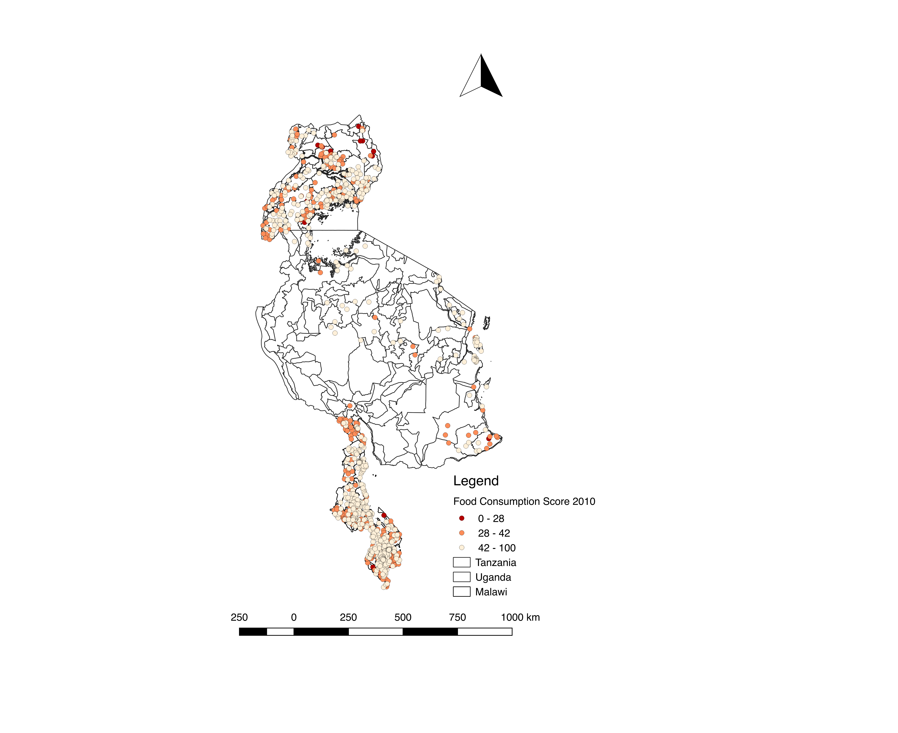
Data
LSMS survey ground truth data
Cluster averages
Categorized using cutoffs
Uganda/Tanzania/Malawi
Three different rounds each with broad spatial coverage

Slide 12
Decisions, decisions
Categorical versus continuous prediction
If categorical, how do we address rare events?
How do we split the data?
What algorithm do we use?

Slide 13
Categorical vs Continuous?
Focus on the categorical prediction for the given cutoffs of each food security measures.
Recall rate of the insecure villages is more important than the over all accuracy.
Typically, classifiers are more sensitive to detecting the majority class and less sensitive to the minority class.
Close to the actual policy scenarios where policy makers need to locate places with most insecure households.
Apply the down sampling, over sampling, and synthetic data techniques to force the model to learn about the tail of the distribution

Slide 14
Methodology: Detecting Rare but Relevant households
FCS
HDDS
rCSI

Slide 15
Methodology:
Down sampling, Over sampling and Synthetic data
Notes:
SMOTE is an over-sampling method. What it does is, it creates synthetic (not duplicate) samples of the minority class. Hence making the minority class equal to the majority class. SMOTE does this by selecting similar records and altering that record one column at a time by a random amount within the difference to the neighbouring records.

Slide 16
Methodology: Classification Algorithms
For structured data like ours (unlike text or pure image), tree-based methods are popular.
Classification Tree (base learner)
Random Forest ( parallel )
Gradient Boosting (sequential)

Slide 17
Recall (are we getting all the insecure households ?)
Precision (are we mistakenly categorizing secure households as insecure?)
F-1 score (balance recall and precision)
Overall categorical accuracy
Methodology: Result Measurements

Slide 18
Raw data
Temperature
Length of dry spell in the last growing season
Features
Train/Test Splits
Models
Baseline
Cross-validation
Rain
Grain prices
Geospatial coordinates of markets, major cities, villages
Household surveys
Labels
Categorical
Maize price in previous month in the nearest market
Average roof type of the village
Measurement
Interpretation
Distance from village to nearest major roads
ML models
Sampling
Segmentation
Error Analysis

Slide 19
Methodology: Baseline Model
Logistic Regression
Data split: year split (cross-validated)
Data segmentation : by country
Down/over sampling: None
Variable groups:
Market : food price, market thinness
Asset: cellphone ownership, floor/roof material, asset index
Weather: dry spells, average temperature and rain
Location: elevation, distance to road, urban/rural

Slide 20
Methodology: Cross-validation
Rare events of food insecurity tend to vary a lot year by year, i.e. 1 or 2 cases in a good year vs over 50 cases in a bad year
Use any two years as training data to predict the third year
Average out the performance after cross-validation to get more stable and trustworthy result

Slide 21
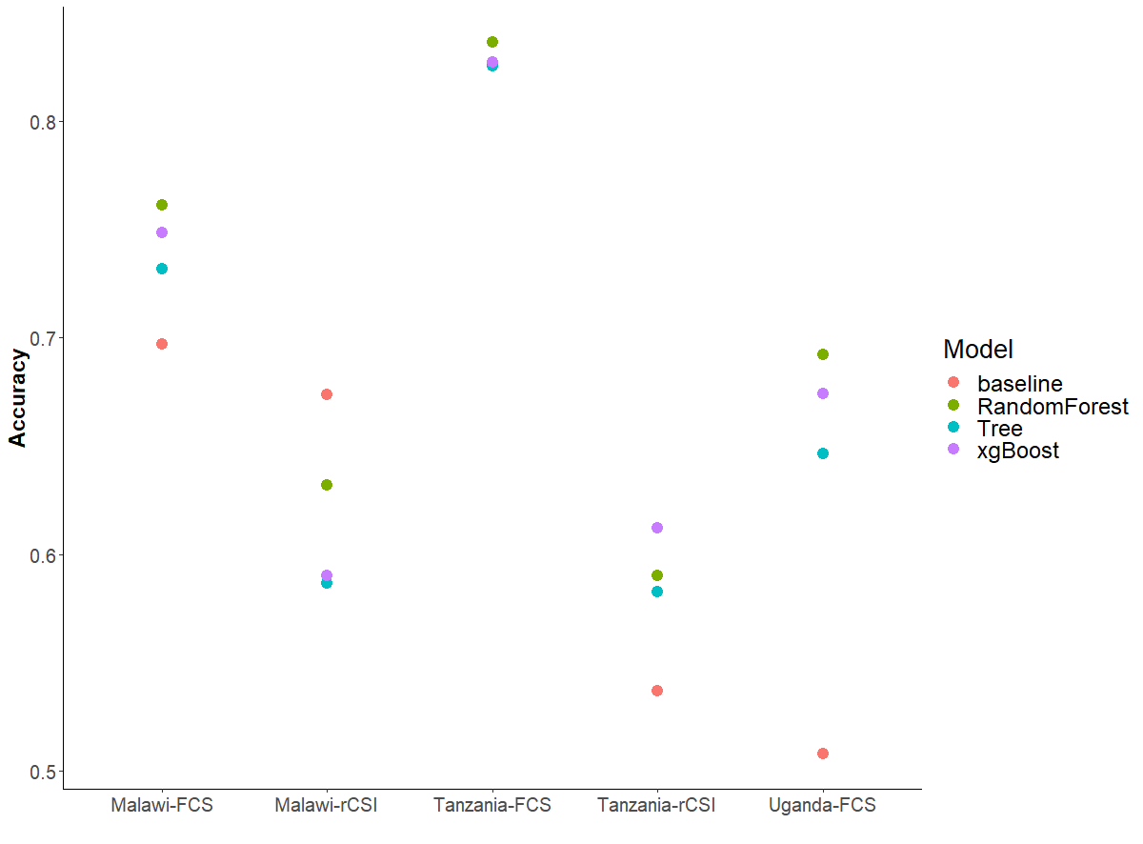
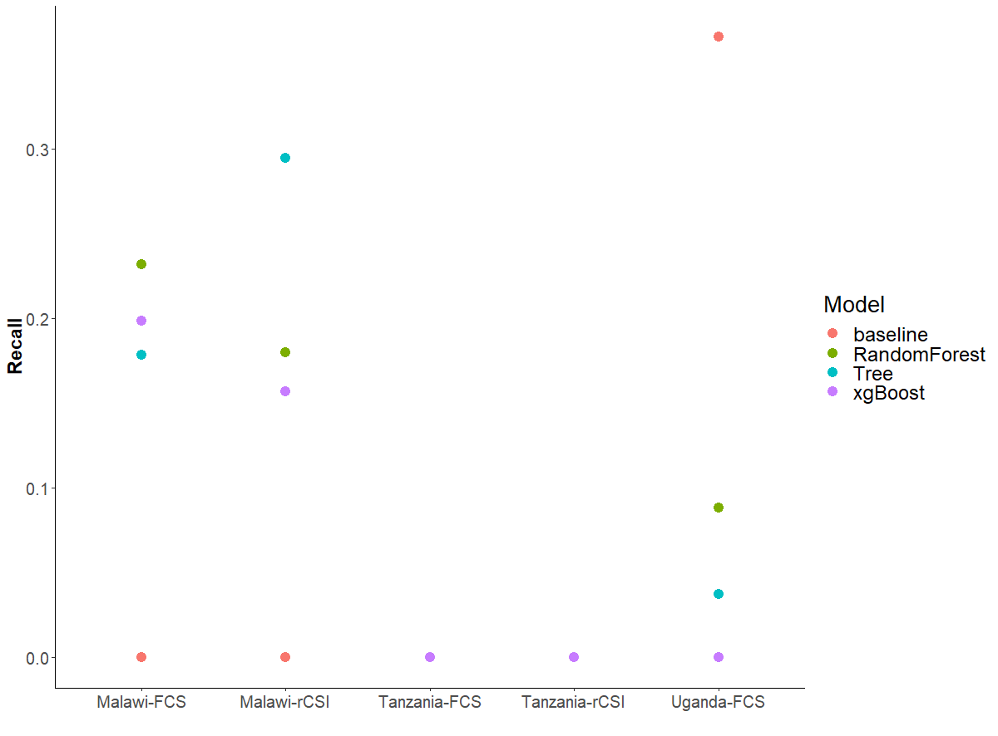
Baseline vs ML algorithms (year split)
Notes:
Need to have a column on overall splits

Slide 22
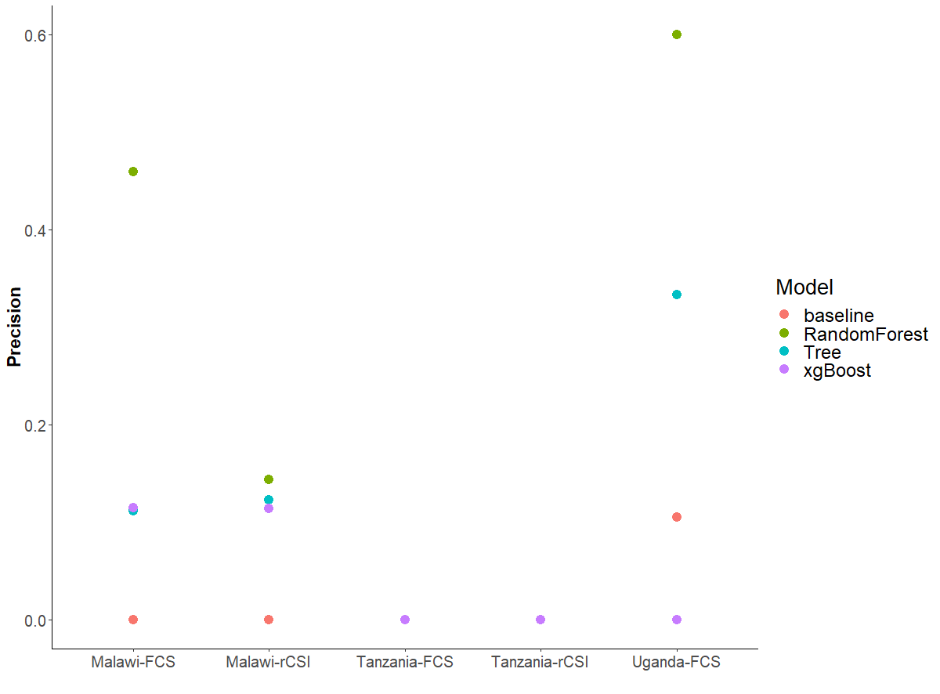
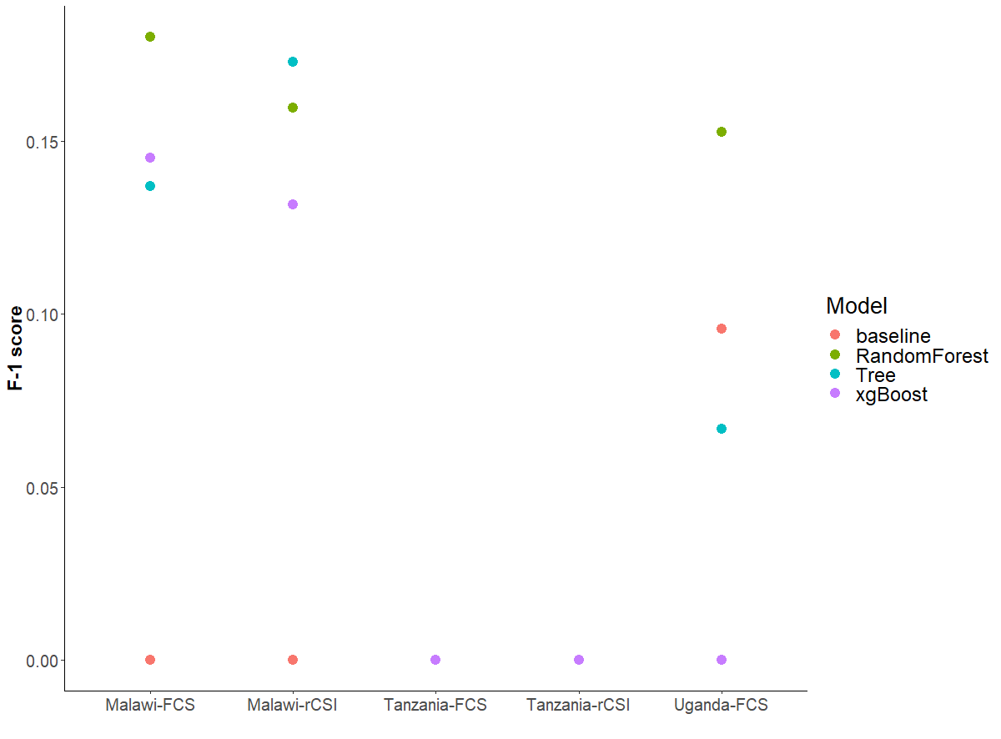

Slide 23
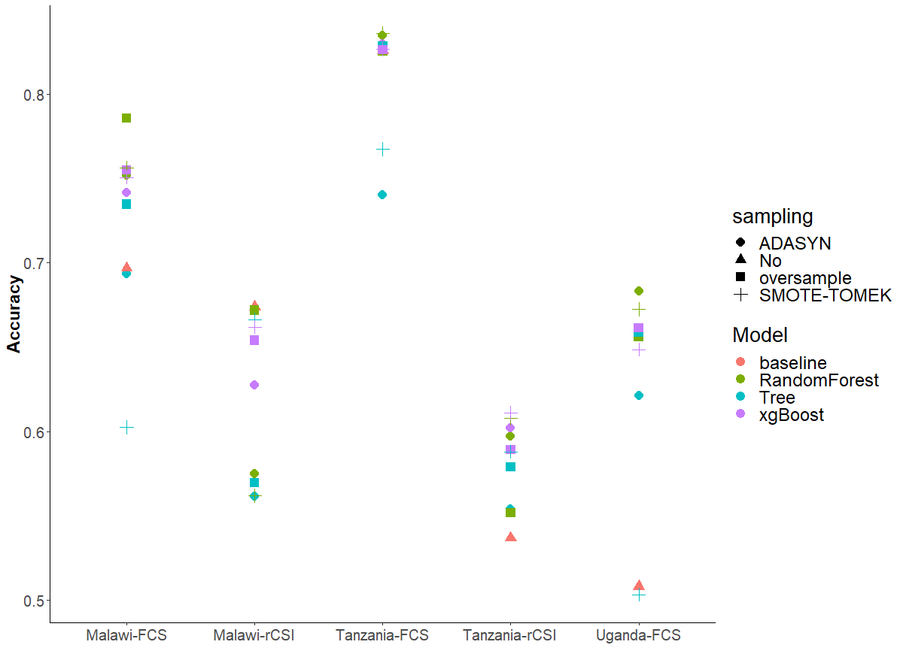
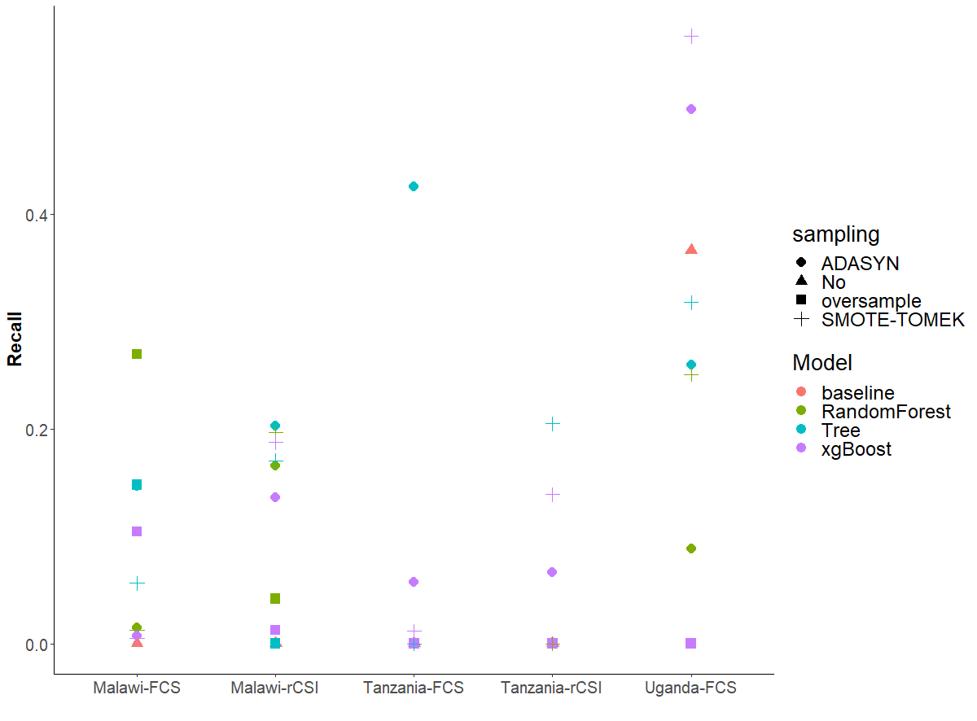
Baseline vs ML algorithms with down/over sample technique

Slide 24
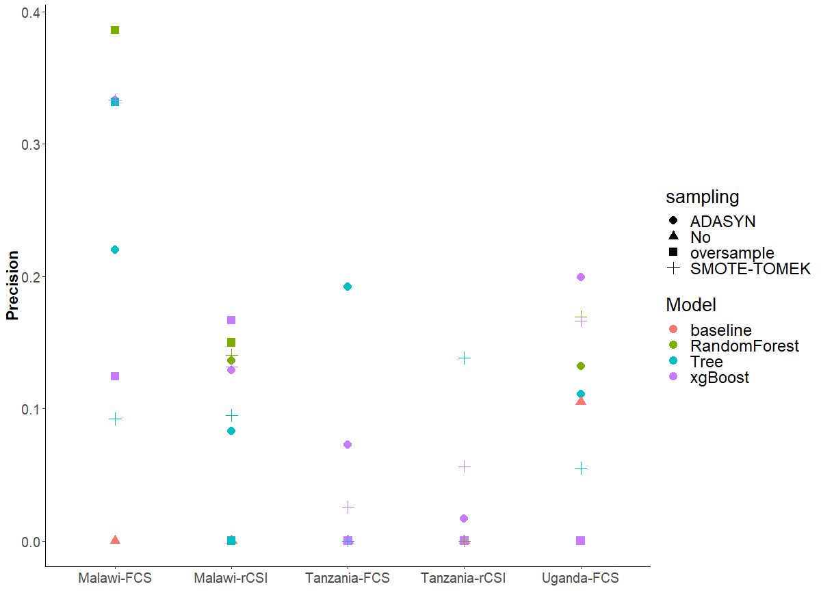
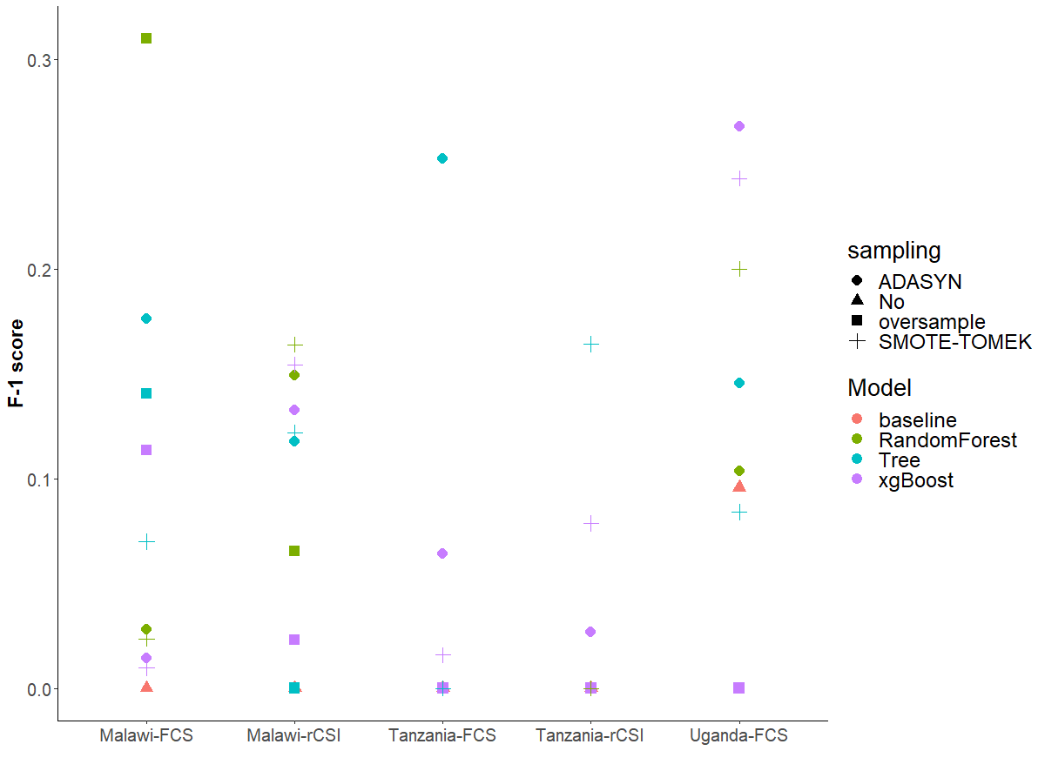

Slide 25
Binary cutoff (safe vs not)
Compared to three/four category cutoffs:
Coarser classification of clusters that may require assistance
ROC curve to demonstrate the models’ ability to classify the unsafe category accurately
more data in the minority class to make the models work better
Receiver Operating Characteristic (ROC) curve
The curve plots the true positive rate (TPR) or recall against the false positive rate (FPR) at different values of threshold, where the threshold is defined as the probability cutoff of treating an instance as 1.
The false-positive rate measures the cases we have a “false alarm.”
The area under the ROC curve (AUC) is a universal statistic for model comparison in the machine learning practices.

Slide 26
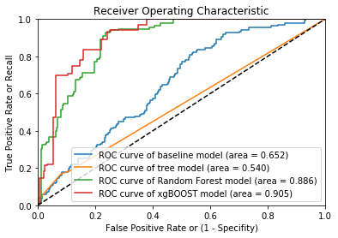
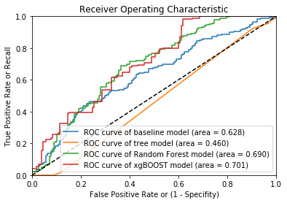
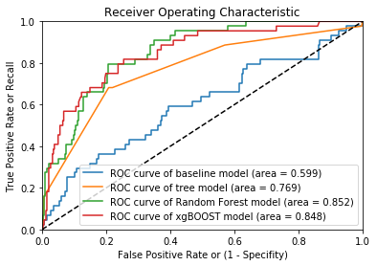
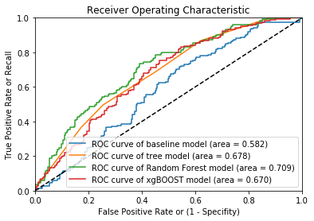
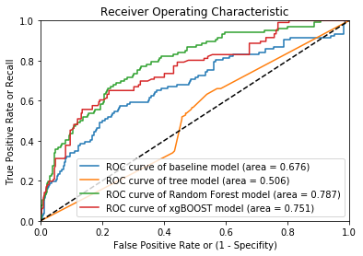

Slide 27
Feature importance
Cellphone <0.53？
Mean temp
< 24.6 ？
Natural Roof percent<0.3?
Distance to admarc road< 2km？
Asset index< -0.058?
Bean price < 47.43?
Cellphone <0.53？
Mean temp
< 24.6 ？
Natural Roof percent<0.3?
Total rain <779？
Floodmax rain < 832.6?
Bean price < 47.43?
Original
Oversample

Slide 28
Random Forest Feature importance
Variable | Importance | Std
number_celphones | 0.12 | 0.11
cell_phone | 0.09 | 0.10
roof_natural | 0.05 | 0.06
asset_index | 0.04 | 0.03
FS_month | 0.04 | 0.02
floor_dirt_sand_dung | 0.03 | 0.06
dist_popcenter | 0.03 | 0.02
dist_road | 0.03 | 0.02
percent_ag | 0.03 | 0.02
maxdaysnorain | 0.03 | 0.02
lhz_beans_price | 0.03 | 0.02
dist_admarc | 0.03 | 0.02
floodmax | 0.02 | 0.02
clust_maize_mktthin | 0.02 | 0.02
Variable | Importance | Std
roof_natural | 0.11 | 0.07
cell_phone | 0.09 | 0.10
floor_dirt_sand_dung | 0.08 | 0.04
number_celphones | 0.05 | 0.10
roof_iron | 0.04 | 0.06
day1rain | 0.04 | 0.01
clust_beans_price | 0.04 | 0.01
lhz_maxdaysnorain | 0.03 | 0.02
lhz_nuts_mktthin | 0.03 | 0.01
asset_index | 0.03 | 0.02
household_head_age | 0.03 | 0.02
clust_maize_price | 0.03 | 0.02
dist_road | 0.03 | 0.02
Original
Oversample

Slide 29
XGBOOST Feature importance
Variable | Importance
roof_natural | 0.11
cell_phone | 0.09
floor_dirt_sand_dung | 0.08
number_celphones | 0.05
roof_iron | 0.04
day1rain | 0.04
clust_beans_price | 0.04
lhz_maxdaysnorain | 0.03
lhz_nuts_mktthin | 0.03
asset_index | 0.03
Household_head_age | 0.03
clust_maize_price | 0.03
dist_road | 0.03
clust_maize_mktthin | 0.02
Variable | Importance
Cellphone | 0.11
num_cell | 0.09
floor_dirt_sand_dung | 0.07
roof_iron | 0.06
asset_index | 0.06
dist_popcenter | 0.06
lhz_day1rain | 0.06
lhz_maize_price | 0.06
dist_road | 0.06
Household_head_age | 0.05
region19 | 0.05
percent_ag | 0.05
region9 | 0.05
Variable | Importance
num_cellphones | 0.15
roof_iron | 0.15
region3 | 0.15
dist_road | 0.12
floor_dirt_sand_dung | 0.12
roof_natural | 0.12
Cellphone | 0.12
floodmax | 0.08
Malawi FCS
Tanzania FCS
Uganda FCS

Slide 30
Methodology: Data Split
Split by year, by region or random
For different application purposes and different data structures

Slide 31
Methodology: Data Segmentation
By country
Entire dataset of three countries
By urban and rural
4. Auto-segmentation by training a shallow tree in each country based on observables
Original data set
By Country
Malawi
Tanzania
Uganda
Original data set
Tree
Node 1
Node 2
Node 3
Node 4

Slide 32
Methodology: Generalization and Update
Model generalization:
what happens when we directly apply models trained on one country/region to predict another
Model deploy and update:
compare the results of using one year, with a dynamic process of constantly updating model with new survey data

Slide 33
Future Steps:
1. Error analysis and feature importance analysis
by region
by group
by month
2. Variables that explains the variations, especially poor households
Market variables, which crop and where
Weather variables: dry spell, rainfall related signs
Assets, cellphone ownership

Slide 34
Conclusions
Combined with data techniques, machine learning methods not only improve prediction accuracy in general, but particularly on households that are vulnerable to food price shocks.
An automated, updated and scalable food security system based on publicly available data, advanced data techniques can assist the work of food aid and humanitarian responses in a timely, transparent, and efficient fashion.

Slide 35
Thank you !

